Slide 1
Movie streaming Recommender

Slide 2

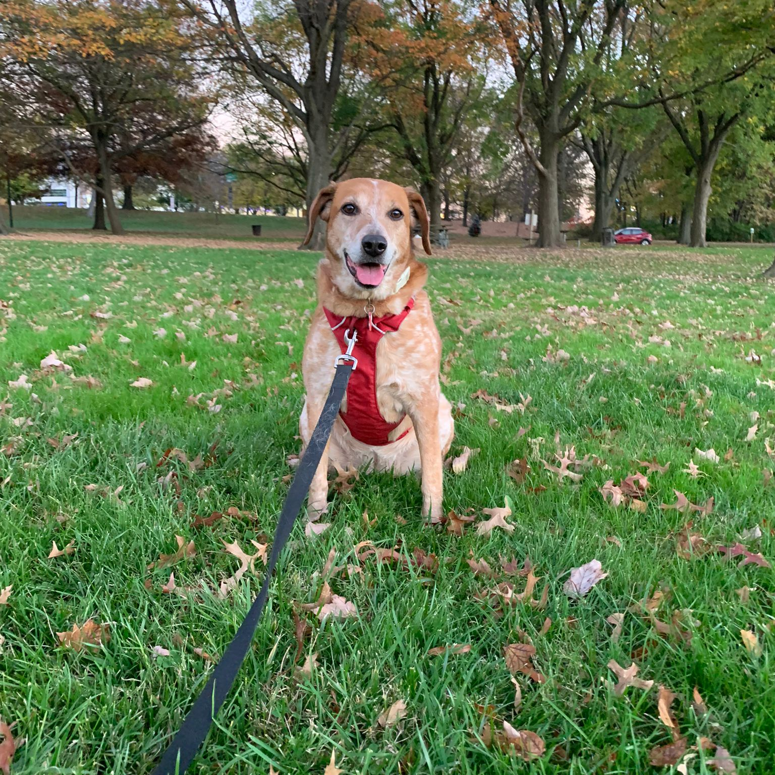
MEET OUR TEAM
Avery Davidowitz
Dixie
Data Engineer
PAWS Support Staff

Slide 3
AGENDA
Business Objectives​
Data Pipeline
​Recommender Implementation
​Conclusion​

Slide 4
Business Objectives​
Launching a new movie streaming service
Recommender system for app launch
Dynamic systems growth
Overcoming a COLD START
Interactions
Item Metadata
User Metadata

Slide 5
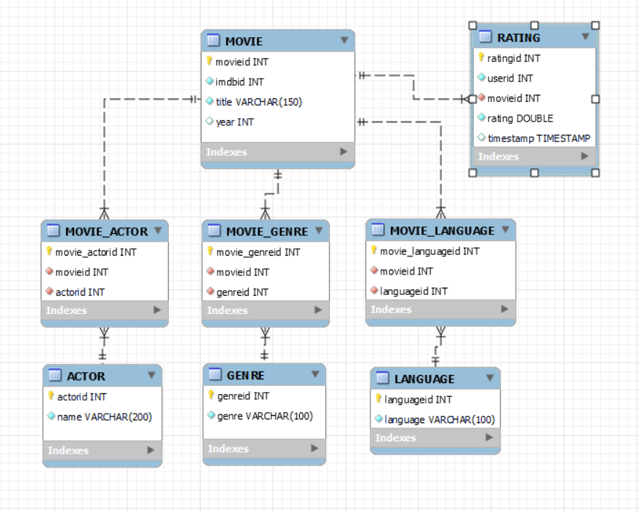
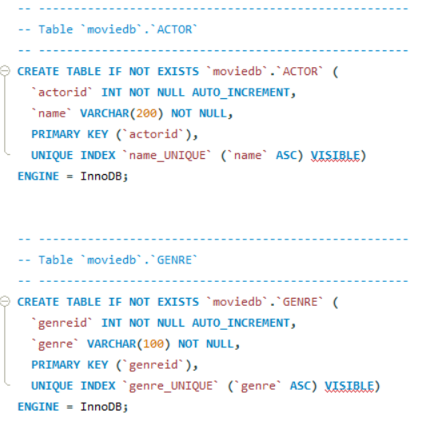
MySQL DB
ER Diagram
CREATE Script

Slide 6
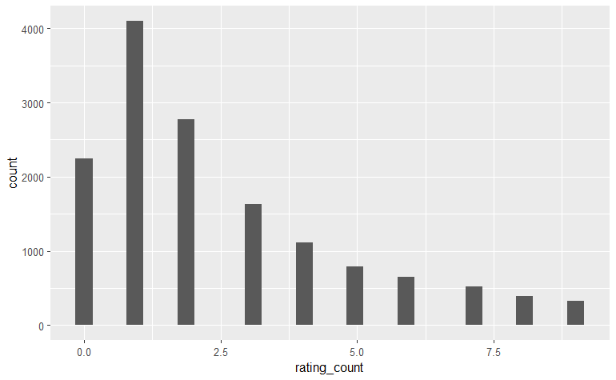


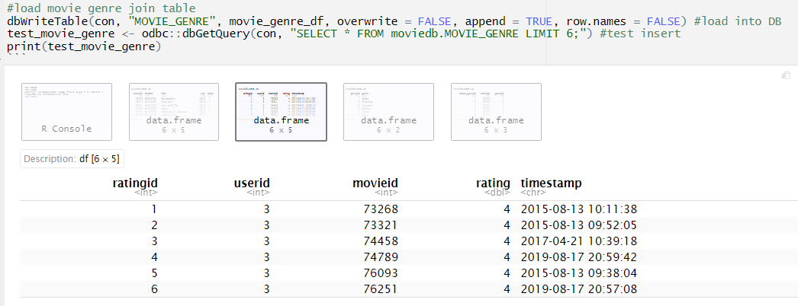

Interactions
By University of Minnesota

Slide 7
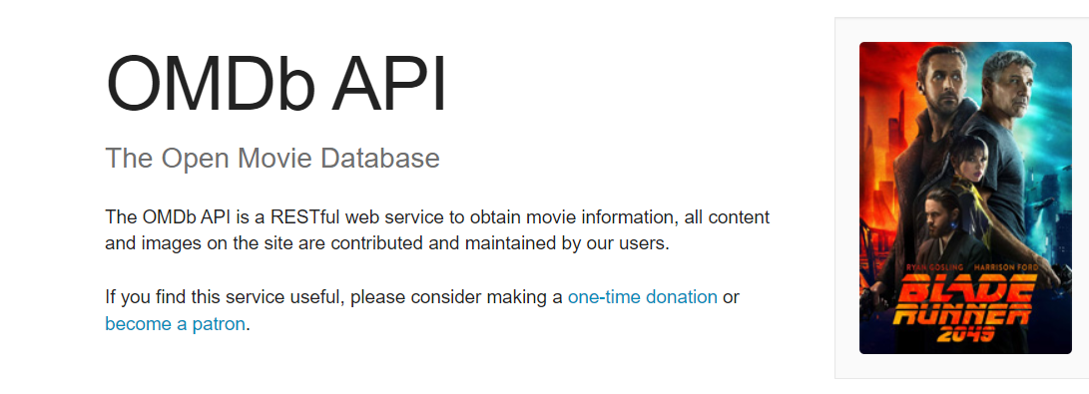
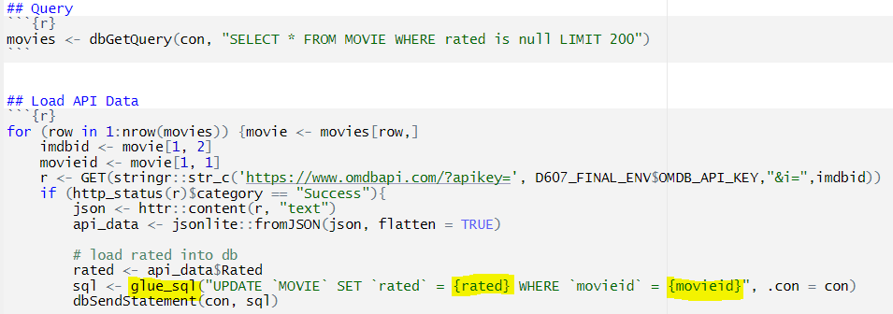
Item Metadata
Query DB
GET API Data
UPDATE DB

Slide 8
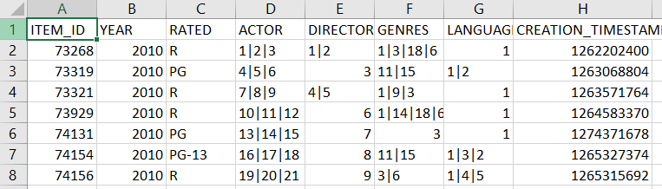
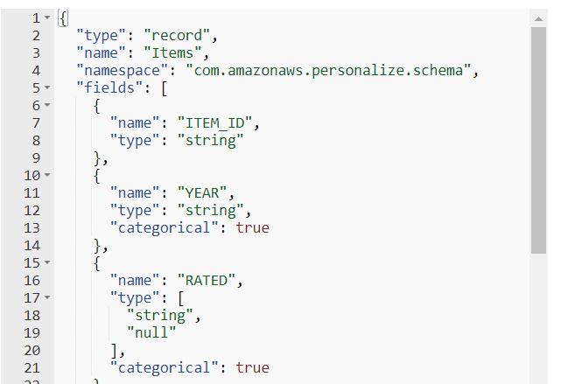
AVRO SCHEMA
CSV > S3 Bucket > AWS Personalize

Slide 9
Tidy dataPIPES are all alike, but every messy dataPIPE is messy in its own way
“
”
Avery Davidowitz

Slide 10
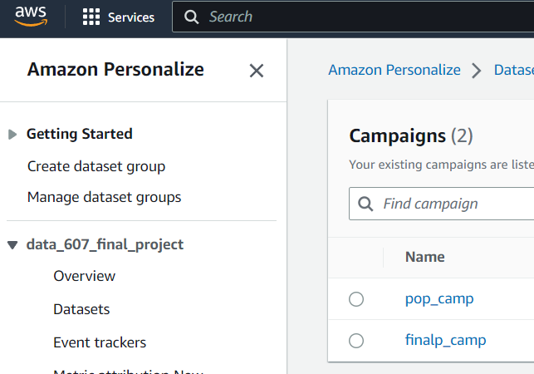
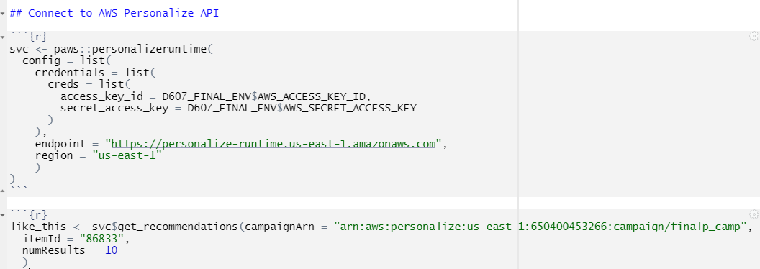
PAWS

Slide 11
The END

Slide 12
Resources
AWS Personalize Developer Guide
PAWS Documentation
Amazon Personalize Demos

